Slide 1
O How Great the Goodness of Our God
Lesson 8
Notes:
Book of Mormon Lesson 8 - O How Great the Goodness of Our God

Slide 2
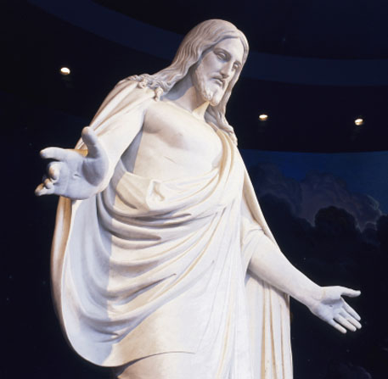
Recap Lesson 7
Strengthen testimonies of the Prophet Joseph Smith
Encourage us to find happiness through trusting in the Lord and keeping His commandments
Notes:
Purpose

Slide 3
Purpose
Understand our need for the Atonement of Jesus Christ
Learn how to receive all the blessings of the Atonement
Notes:
Purpose

Slide 4
Sermon on the Mount
Notes:
Sermon on the Mount (62166; Gospel Art Picture Kit 212)

Slide 5
Jesus Healing the Blind
Notes:
Jesus Healing the Blind (62145; Gospel Art Picture Kit 213)

Slide 6
Jesus Stilling the Storm
Notes:
Stilling the Storm (62139; Gospel Art Picture Kit 214)

Slide 7
Jesus Blessing Jairus’s Daughter
Notes:
Jesus Blessing Jairus’s Daughter (62231; Gospel Art Picture Kit 215)

Slide 8
Christ with the Children
Notes:
Christ with the Children (62467; Gospel Art Picture Kit 216)

Slide 9
Jesus Praying in Gethsemane
Notes:
Jesus Praying in Gethsemane (62175; Gospel Art Picture Kit 227)

Slide 10
The Crucifixion
Notes:
The Crucifixion (62505; Gospel Art Picture Kit 230)

Slide 11
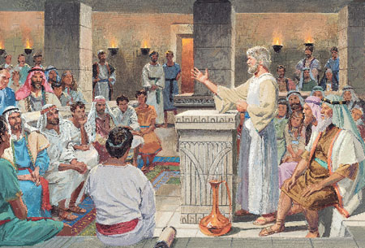
Jacob’s discourse about the Atonement of Jesus Christ
Notes:
2 Nephi 9 contains a discourse by Jacob, one of Nephi’s younger brothers, about the Atonement of Jesus Christ, which is the central event in the plan of salvation. To understand the teachings in this chapter, it is helpful to know how Jacob referred to temporal death and spiritual death

Slide 12
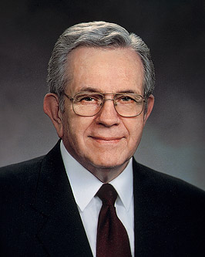
Elder Boyd K. Packer
“The discouraging idea that a mistake (or even a series of them) makes it everlastingly too late, does not come from the Lord. He has said that if we will repent, not only will He forgive us our transgressions, but He will forget them and remember our sins no more”
Notes:
see Isaiah 43:25; Hebrews 8:12; 10:17; Alma 36:19; D&C 58:42)
Conference Report, Apr. 1989, 72; or Ensign, May 1989, 59

Slide 13
Conclusion
2 Nephi 10:25 Wherefore, may God raise you from death by the power of the resurrection, and also from everlasting death by the power of the atonement, that ye may be received into the eternal kingdom of God, that ye may praise him through grace divine. Amen.
Notes:
Conclusion

