Slide 1
He Inviteth All to Come unto Him
Lesson 10
Notes:
Book of Mormon Lesson 10 - He Inviteth All to Come unto Him

Slide 2
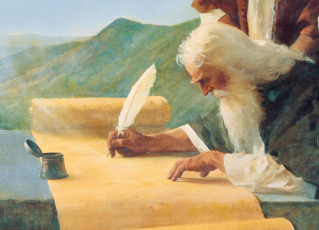
Recap Lesson 9
Understand how the prophecies of Isaiah apply in our lives
Notes:
Recap Lesson 9

Slide 3
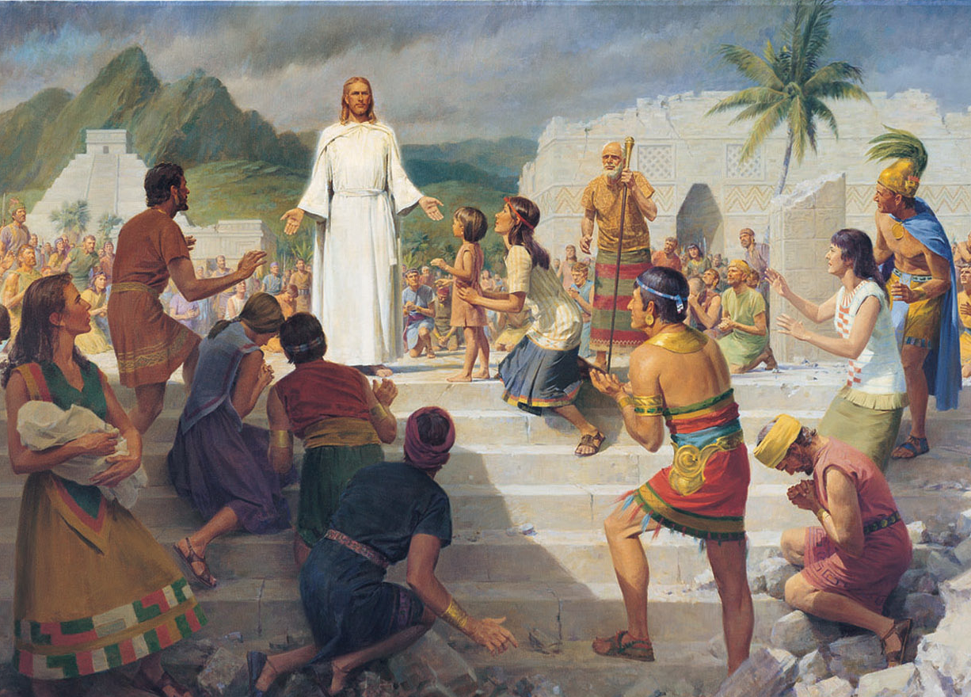
Purpose
Understand that through the Restoration of the gospel and the teachings of the Book of Mormon, the Lord will cause truth to triumph over evil.
Notes:
Purpose

Slide 4
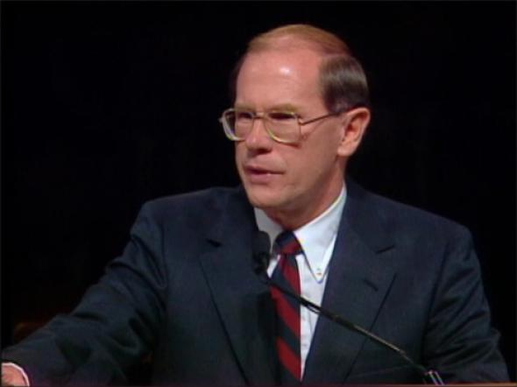
Elder Gene R. Cook
“Last summer on a lonely stretch of desert highway, we saw ahead what appeared to be the road covered with water. My children would have wagered their entire savings on that fact. But within a few minutes we were at the distant spot and saw not one drop of water. What an illusion!
“How many things there are in this life that appear to be one way and all of a sudden are the reverse. … Satan . . . creates illusions in an attempt to detour, dilute, and divert the power and the attention of the Latter-day Saints from the pure truth of God”
Notes:
“Last summer on a lonely stretch of desert highway, we saw ahead what appeared to be the road covered with water. My children would have wagered their entire savings on that fact. But within a few minutes we were at the distant spot and saw not one drop of water. What an illusion!
“How many things there are in this life that appear to be one way and all of a sudden are the reverse. … Satan operates that way. He is the master of illusion. He creates illusions in an attempt to detour, dilute, and divert the power and the attention of the Latter-day Saints from the pure truth of God”
Conference Report, Apr. 1982, 35–36; or Ensign, May 1982, 25

Slide 5
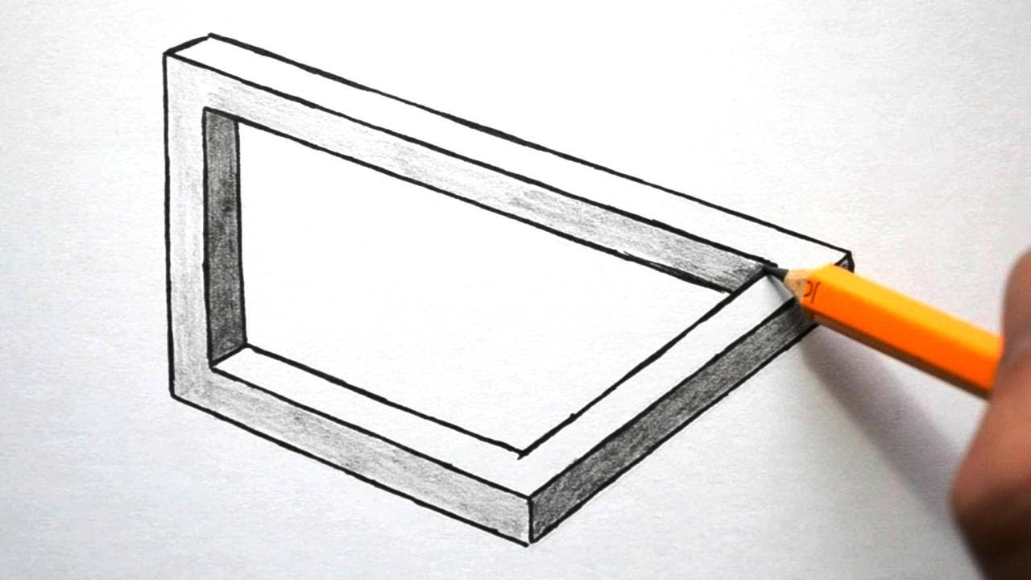
What is an illusion?

Slide 6
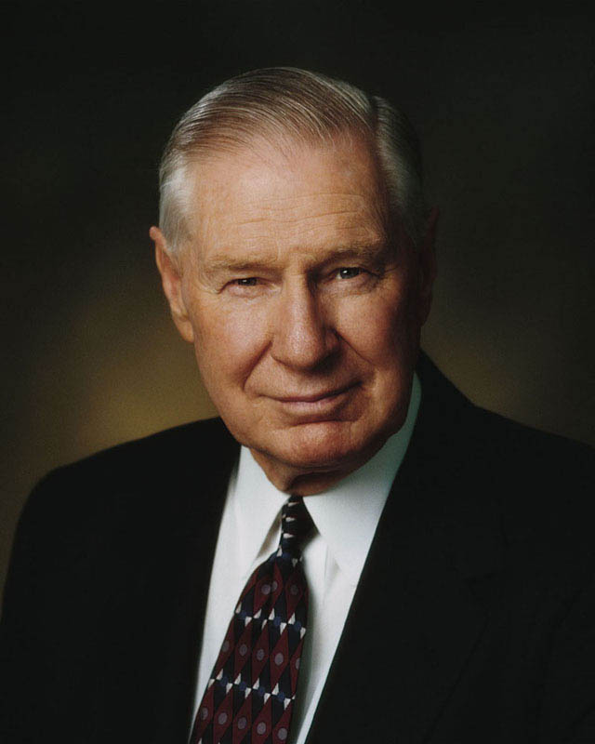
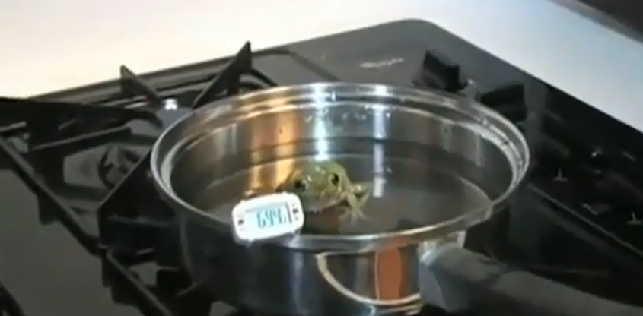
Elder James E. Faust
Notes:
Elder James E. Faust shared the following analogy:
“Author and commentator Malcolm Muggeridge once told a story about some frogs who were killed without resistance by being boiled alive in [a] cauldron of water. Why didn’t they resist? Because when they were put in the cauldron, the water was tepid. Then the temperature was raised ever so slightly, … then a bit warmer still, and on and on and on. The change was so gradual, almost imperceptible, that the frogs accommodated themselves to their new environment—until it was too late. The point that Mr. Muggeridge was making was not about frogs but about us and how we tend to accept evil as long as it is not a shock that is thrust on us abruptly. We are inclined to accept something morally wrong if it is only a shade more wrong than something we are already accepting’” (National Press Club Forum).
After sharing this analogy, Elder Faust said, “This gradual process was foretold by ancient prophets”
Conference Report, Apr. 1989, 40; or Ensign, May 1989, 32

Slide 7
Conclusion
Through studying the Book of Mormon and living the gospel, we will gain the power to avoid Satan’s deceptive illusions and be guided as we strive to stay on the strait and narrow path.
Notes:
Conclusion

