Slide 1
Ye Shall Be Called the Children of Christ
Lesson 16
Notes:
Book of Mormon Lesson 16 - Ye Shall Be Called the Children of Christ

Slide 2
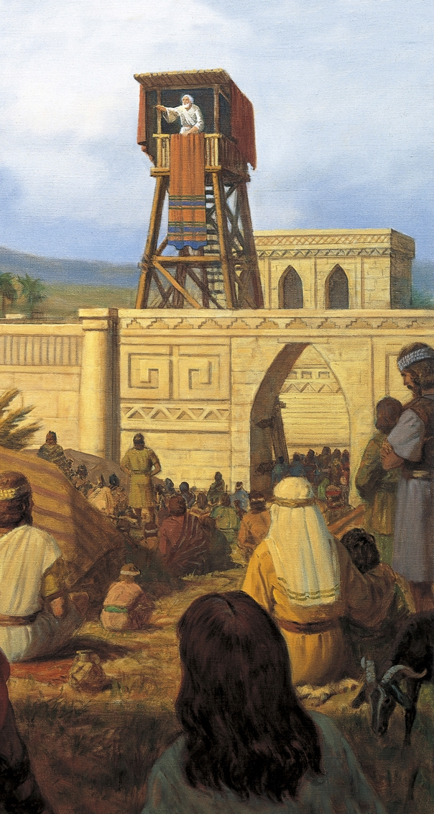
Recap Lesson 15
Increase our understanding of our indebtedness to God
encourage us to “[put] off the natural man … through the atonement of Christ the Lord”.
Notes:
Recap Lesson 15

Slide 3
Purpose
Seek and maintain the “mighty change” of heart that comes through exercising faith in Jesus Christ.
Notes:
Purpose

Slide 4
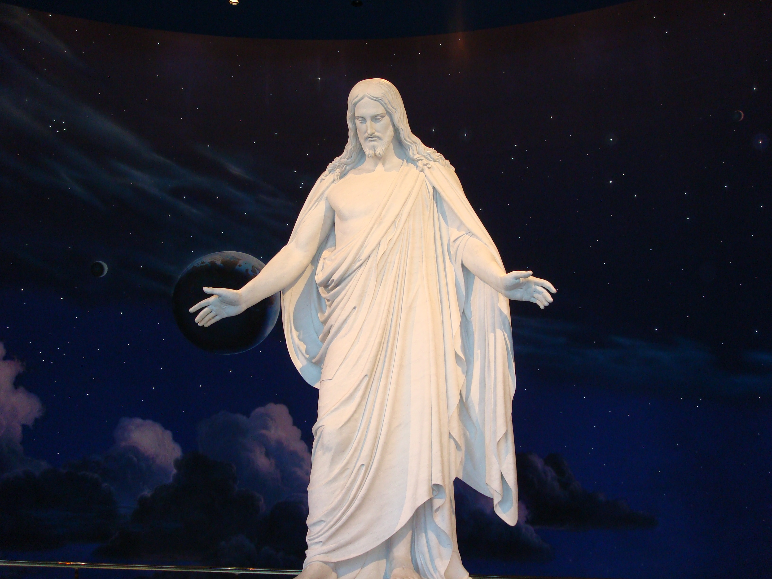
Right hand
Left hand

Slide 5
Notes:
King Benjamin (62298; Gospel Art Picture Kit 307)

Slide 6
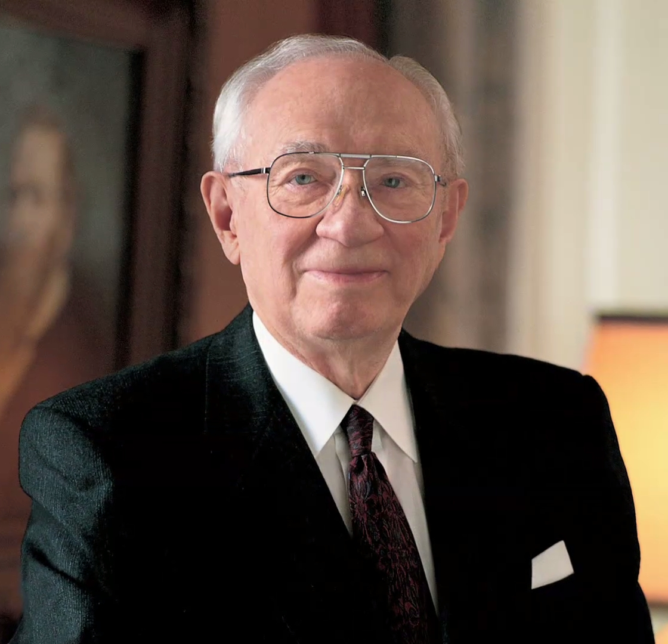
Gordon B. Hinckley
“The health of any society, the happiness of its people, their prosperity, and their peace all find their roots in the teaching of children by fathers and mothers”
Notes:
Conference Report, Oct. 1993, 79; or Ensign, Nov. 1993, 60

Slide 7
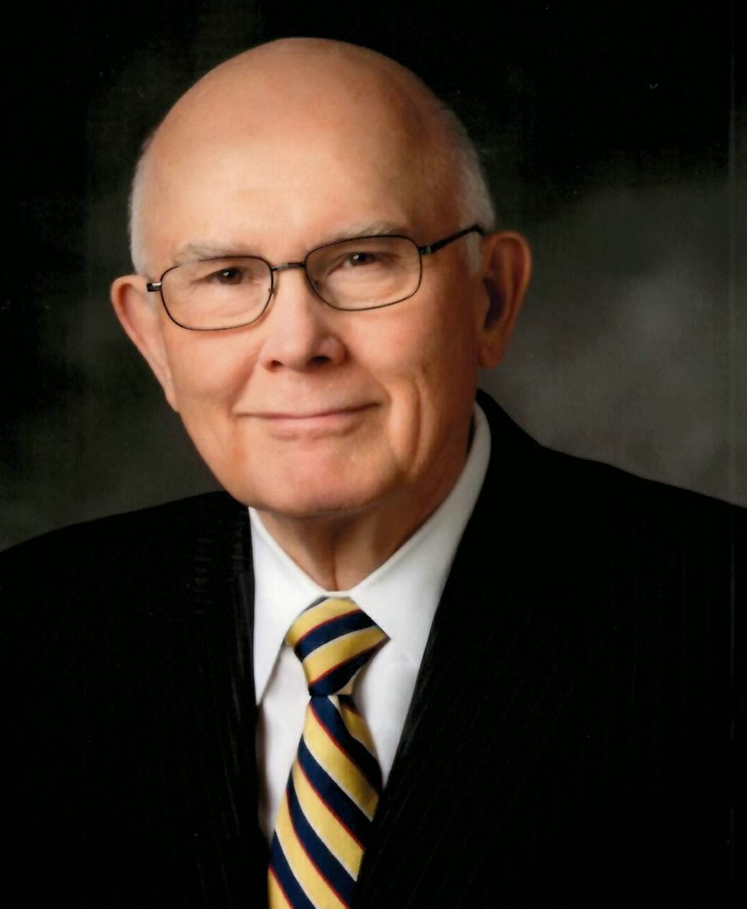
Elder Dallin H. Oaks
“Our willingness to take upon us the name of Jesus Christ affirms our commitment to do all that we can to be counted among those whom he will choose to stand at his right hand . . . our witness . . . constitutes our declaration of candidacy for exaltation in the celestial kingdom.”
Notes:
“Our willingness to take upon us the name of Jesus Christ affirms our commitment to do all that we can to be counted among those whom he will choose to stand at his right hand and be called by his name at the last day. In this sacred sense, our witness that we are willing to take upon us the name of Jesus Christ constitutes our declaration of candidacy for exaltation in the celestial kingdom. Exaltation is eternal life, ‘the greatest of all the gifts of God’ (D&C 14:7)”
Conference Report, Apr. 1985, 105; or Ensign, May 1985, 83

Slide 8
Conclusion
King Benjamin’s blessings are available to each of us.
Seek and maintain that “mighty change” of heart that will enable them to be children of Christ.
Notes:
Conclusion

