Slide 1
Internet and Media Safety for Families
Lesson 3 Internet and Media Safety for Families
<Ward name> <Date>
Notes:
Internet and Media Safety for Families
The Internet and media have become important, positive elements of our lives
Like other technologies that we use regularly, we need to manage the Internet and Media in our families
We all have rules in our family around appropriate television watching
We have rules for the safe operation of automobiles and other equipment like chain saws because they can be dangerous
We don’t let our children wander around with chain saws
We wear helmets when we ride a bicycle
The Internet and media are no different, just newer and perhaps less familiar to us than the other slightly older and more widely accepted technologies in our lives
We don’t watch certain movies, we don’t let some DVD’s into our homes
In the same way, we avoid inappropriate content on the Internet
How do we actually achieve this goal and ensure our families do likewise?
That’s what we want to talk about today
Some of you grandparents may think this presentation isn’t relevant to you; I disagree; you can be enormously influential among your children, their spouses and your grandchildren
Lesson created by Yogi Schulz in the fall of 2013 YogiSchulz@corvelle.com

Slide 2
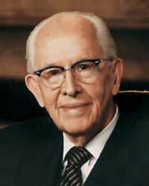
Lesson 2 Review The Sacred Roles of Fathers and Mothers
Write a letter to your father or your mother
With your spouse, review President Ezra Taft Benson’s 10 suggestions for fathers and mothers
Discuss ways you can work together and support one another in these parenting responsibilities
Assess if the signs of cyberbullying are evident among your children
Complete Home Inventory Worksheet
Notes:
Lesson 2 Review - The Sacred Roles of Fathers and Mothers
Write a letter to your father or your mother
With your spouse, review President Ezra Taft Benson’s 10 suggestions for fathers, on pages 41–42 in this study guide, and his 10 suggestions for mothers, on pages 45–47
Discuss ways you can work together and support one another in these parenting responsibilities
Assess if the signs of are evident among your children
Complete Home Inventory Worksheet
Are there any experiences with these actions you’d like to share?

Slide 3
Internet and Media Safety for Families 7-Lesson Sunday School Class
Children are an Heritage of the Lord
The Sacred Roles of Fathers and Mothers
Internet and Media Safety for Families
Teach your Children about Media Choices
Teach your Children to prevent/avoid Pornography
Teach Your Children about inappropriate Internet/Media Exposures
Make Emergency Response Plans
Notes:
Internet and Media Safety for Families - 7-Lesson Sunday School Class
This is the list of titles for the 7-Lesson Sunday School Class we have developed
This class relies heavily on the Marriage and Family Relations Part B: Parents’ Responsibilities To Strengthen Families
Lesson 1 - Children are an Heritage of the Lord
Lesson 2 - The Sacred Roles of Fathers and Mothers
Lesson 3 - Internet and Media Safety for Families
Lesson 4 - Teach your Children about Media Choices
Lesson 5 - Teach your Children to prevent/avoid Pornography
Lesson 6 - Teach Your Children about inappropriate Internet/Media Exposures
Lesson 7 - Make Emergency Response Plans

Slide 4
Technology is always a two-edged Sword
Notes:
Technology is almost always a two-edged Sword
As a society, we have benefited enormously from all the technology advances that have occurred over thousands of years
However, each new technology also brings new risks to our society and our lives
Here are some examples
Nuclear power – it’s a source of electrical power and has the ability to annihilate millions of people
Automobiles – Cars provide wonderful transportation but also have a risk of accidents that can lead to death
DVD’s - DVD’s can provide wonderful entertainment and spiritual gospel instruction; unfortunately some people also use DVD’s to distribute horrible content that is faith and testimony undermining
Hot dog roasters – We could discuss many technology examples at length but that’s not what we’re here for today
Let me close with the example of the hot dog roaster; we’ve all used these; this innocuous, helpful device can also be used violently
Let’s make use of the many benefits of technology and manage the risks
We can’t blithely ignore the risks and think they won’t adversely affect us

Slide 5
Lesson Outline
Lesson Objectives
Family prayer
Family scripture study
Family home evening
Internet Filtering
Suggested Actions
Notes:
Lesson Outline
LESSON 16 - FAMILY PRAYER, FAMILY SCRIPTURE STUDY AND FAMILY HOME EVENING
Families receive great blessings when they pray together
Family scripture study helps families draw nearer to God
Family home evening helps families fortify themselves against worldly influences
Internet Filtering
Suggested Actions

Slide 6
Lesson Objectives
Prayerfully consider ways you might improve:
family prayer
family scripture study
family home evening
Strengthen internet filtering
Notes:
Lesson Objectives
Prayerfully consider ways you might improve one or more of family prayer, family scripture study and family home evening
For example: family prayer – schedule for the same time on most days
For example: family scripture study – align with Sunday lessons
For example: family home evening – make more use of:
Family Home Evening Resource Book (31106)
Family Guidebook (31180)
Family Home Evening Video Supplement (53276)
Family Home Evening Video Supplement 2 (53277)
Strengthen internet filtering
We can apply technology to significantly reduce the risk of inappropriate content entering our home

Slide 7
Families receive great blessings when they pray together
Notes:
Families receive great blessings when they pray together
Let’s avoid basic, standard, routine, superficial prayers
Let’s offer prayers that are more heart-felt, insightful and introspective
Involve the entire family
Plan to pray every day
Avoid skipping prayers due to time pressure

Slide 8
Parent-Child Interviews By Carlos E. Asay
Notes:
Parent-Child Interviews, By Carlos E. Asay
General Conference - October 1983
https://www.lds.org/general-conference/1983/10/parent-child-interviews?lang=eng
This video clip contains about the first 7 minutes of Elder Asay’s 11 minute talk
Consider how you can apply these ideas to your interviews with your children

Slide 9
Twelve Tips for Parent-Child Interviews
Hold interviews regularly
Mothers and fathers can interview children jointly or take turns
Pray beforehand
Begin with a prayer
Plan to listen more than you speak
Don’t compare one child with another
When correcting, give a clear but loving explanation
Agree together what words best describe each problem
Don’t compromise gospel standards “just this once”
Praise each child generously and cheerfully
Bear your testimony often
Don’t discuss one child’s problems with other children
Notes:
Twelve Tips for Parent-Child Interviews By Steven B. Glade
1. Hold interviews regularly. If children know an interview is coming up, they will be more likely to conduct themselves so as to live up to parental expectations.
2. Remember that mothers and fathers can interview children jointly or take turns giving interviews separately. Either one can hold an interview in the absence of the other.
3. Pray beforehand for the Spirit to help you discern problems and know how to counsel your children.
4. Begin with a prayer. Heavenly Father cares about your interview and will help guide the process.
5. Be prepared to listen more than you speak.
6. Don’t compare one child with another.
7. When behavior needs correcting, give a clear but loving explanation of what’s wrong and what needs to change.
8. Agree together what words best describe each problem; then write the problem on a sheet of paper. Direct any criticism to the words on the paper, not to the child.
9. Don’t compromise gospel standards “just this once” out of love for your children. Instead, use gospel standards to guide your decisions.
10. Praise each child generously and cheerfully.
11. Bear your testimony often.
12. Don’t discuss one child’s problems with other children. Keep confidences.
What reactions have your received to the interview idea from your children?
Steven B. Glade, a Gospel Doctrine teacher in the Valley Vista Ward, Las Vegas Nevada Lone Mountain Stake, compiled these tips with the help of the high priests group of the former Las Vegas 36th Ward, Las Vegas Nevada Stake.

Slide 10
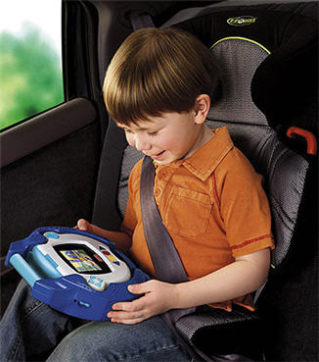
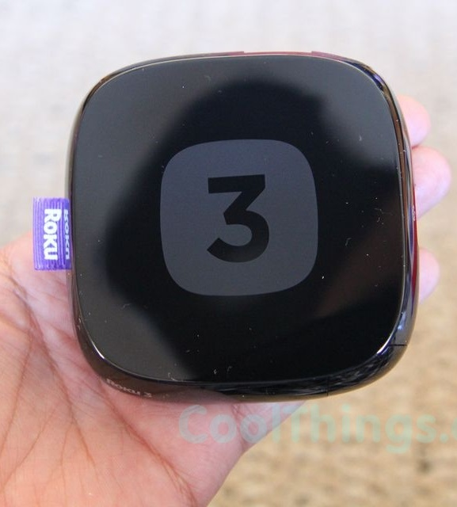
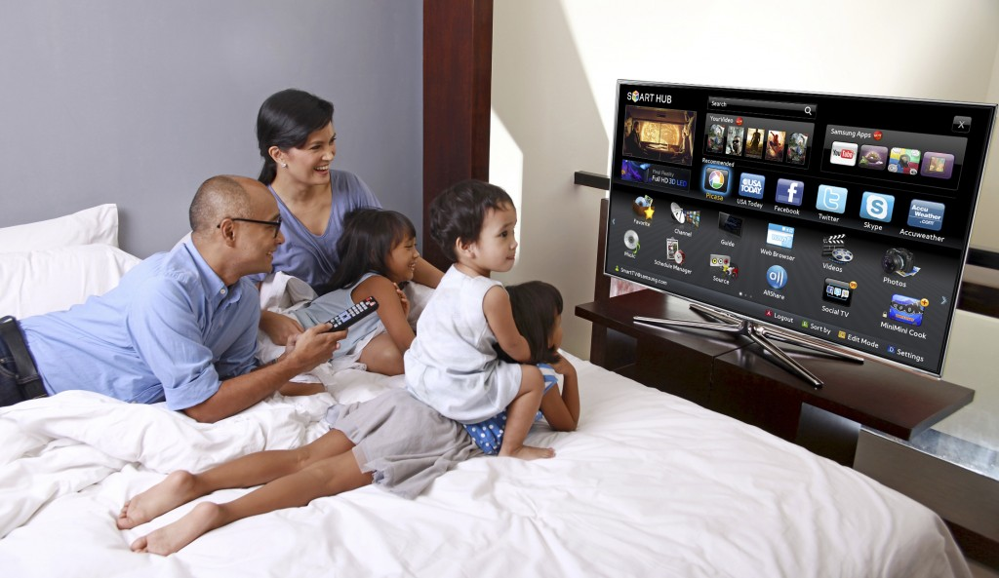
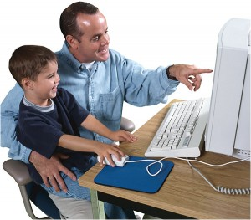
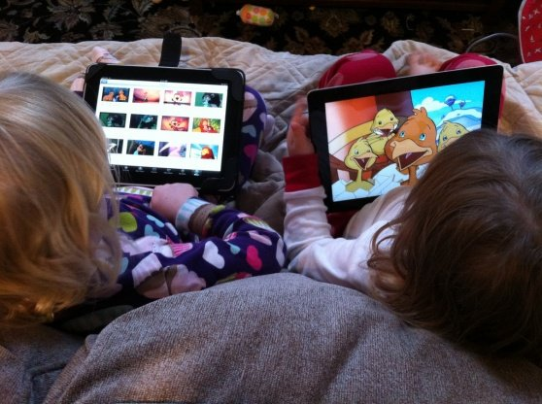
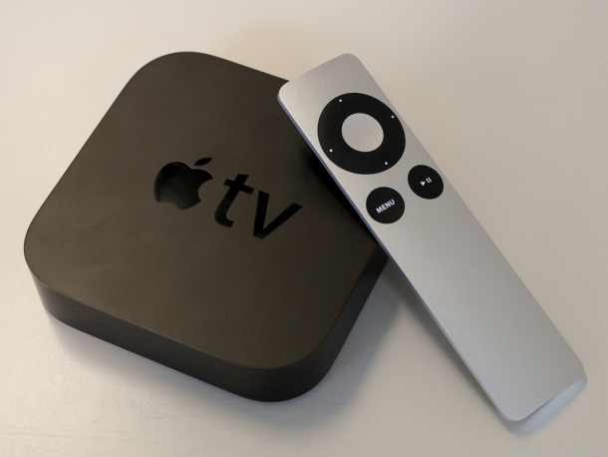
How many of us have these devices in your home?
Television sets
Smartphones
Game consoles
Computers
Tablets
DVD players
Content streaming
How many of these devices can access the Internet?
Notes:
How many of us have these devices in our homes?
Television sets
Smartphones
Game consoles
Computers
Tablets
DVD players
Content streaming devices like:
Roku - http://www.roku.com/ca/what-is-roku
Apple TV - http://www.apple.com/ca/appletv/
Game consoles
Here’s a trick question:
How many of these devices can access the Internet?
Answer: All of them
The Internet is both a wonderful and a dangerous source of information, music and entertainment
That’s Internet duality is what makes our discussion here today both valuable and important
It’s the pervasiveness of the Internet in our society that makes our discussion today both valuable and important for you and your family

Slide 11
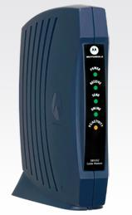
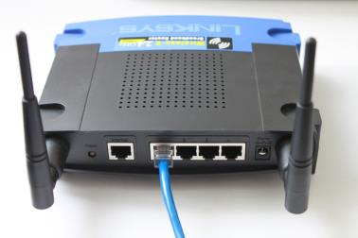
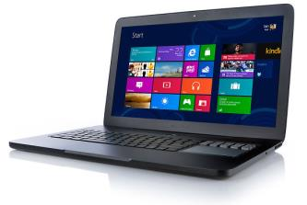
Typical Home Network Configuration
Internet
Shaw Internet modem
In-home router (back view)
Laptop
Notes:
Typical Home Network Configuration
Internet
Shaw or TELUS connects the world-wide Internet to your home
Shaw Internet modem
The Shaw Internet modem or the TELUS ADSL modem converts the signal from the network protocol to Ethernet
Ethernet is the name of the data communication network standard that your computer understands
In-home router
The in-home router distributers the Internet and computer-to-computer information to your attached computers laptops and printers
Most routers can do this either by Wi-Fi wirelessly (the black antennas) or though an Ethernet cable (the blue wire)
The wireless network relies on a radio signal that travels through the air between the computers and this wireless access point
Most routers also contain a firewall to block hacker attacks; by default the firewall is turned on
Routers only act as Internet content filters if you configure them to perform this function; there is nothing automatic about this function
The basic in-home router has 4 ports to plug in Ethernet cables for wired computers
The number of computers that the router can handle wirelessly depends on many factors but dozens is typically not a problem
The router won’t be the bottleneck on your home network; typically the bottleneck to the Internet, when you are surfing the Web on multiple devices at the same time, will be the capacity of the Shaw Internet connection
Laptop
Represents the network-connected computers, laptops, printers, scanners and smartphones you may be using in your home
Often printers and scanners are connected to individual computers rather than the network
Bad short cut
Some people say to themselves: I only have one computer so I will save the $50.00 that the in-home router costs
This is short-sighted because it means you have no firewall to block hacker attacks that can wipe out your data or hijack your computer and turn it into a spam-sending machine

Slide 12
Family scripture study helps families draw nearer to God
Notes:
Family scripture study helps families draw nearer to God
Schedule time to study scriptures together
Try to follow the Sunday School curriculum

Slide 13
Can we avoid technology and turn that into a virtue?
All of our telephone calls are made on a traditional landline!
Notes:
Can we avoid technology progress and turn that avoidance into a virtue?
Cartoon source: Tinas_Groove_2013_12_04.gif
Obviously there’s no relationship between the restaurant’s use of a landline and the quality of its food or the appeal of its ambiance
We are unlikely to provide a safer, more interesting home if we ignore or avoid or outlaw information technology
Rather we need to learn how to manage information technology so that our family can benefit from it

Slide 14
Jaquelline Fuller from Google
Notes:
Jaquelline Fuller from Google
Jaquelline Fuller from Google talks about the monitoring and dialogue they use to protect their children’s safety with media and online
https://www.youtube.com/watch?v=7nfKoslonWg
Length: 2 minutes
Let’s watch this video
Please listen for ideas you’d like to discuss and perhaps implement in your family

Slide 15
Internet Content Filtering
Jeremy, can you help us ?
Notes:
Internet Content Filtering or Parental Controls
Jeremy, can you help us ?
Sure
Click!, Tap!, Tap!, Tap!, Scroll, Scroll, Click
Cartoon: zits_20121110_564787.jpg
Here’s an example of parents struggling with parental controls
Parental controls can be useful to implement
However, recognize that parental controls try to provide a technical solution to the problem of access to inappropriate content that largely requires a non-technical response

Slide 16
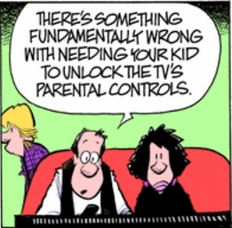
Internet Content Filtering
There’s something fundamentally wrong when you need your kid to unlock the TV’s parental controls.
Notes:
Internet Content Filtering or Parental Controls
Cartoon: zits_20121110_564787.jpg
There’s something fundamentally wrong when you need your kid to unlock the TV’s parental controls
It’s not that difficult to circumvent parental controls; especially with a little technical awareness that most teenagers possess

Slide 17
Internet Content Filtering
To prevent accidental access to inappropriate content, most filters can be successful
Unfortunate side-effect of most filters is the false sense of security that they provide
Notes:
Internet Content Filtering
If you are attempting to prevent accidental access to inappropriate content, then most filters can be considered successful
Many filters also have other features, such as time controls, chat logging, reporting and other useful capabilities
All of these features help keep our family safe, and help provide us with more information regarding how our computers are being used
From this perspective, it would be safe to say that filters work
The unfortunate side-effect of most filters is the false sense of security that they provide
Most teenagers can get around software filters if they want to
Sometimes family members can just connect to the neighbor’s open wireless access point
Hardware filters and OpenDNS are trickier to circumvent
Even though we deliberately talk about technology in this course, the best defense against these issues is to:
Build and maintain a good relationship with your children as every parent tries to do
Help children overcome temptations of all kinds including those found on the Internet and in media

Slide 18
Internet Content Filtering Alternatives
Software
Software for every machine in your home
Lots of flexibility and selectivity; lots of management
Hardware
Filters all devices in the home
Limited selectivity; no management
DNS service
Filters all devices in the home
Considerable selectivity; low management
Internet proxy
Filters all devices in the home
Limited selectivity; no management
Notes:
Internet Content Filtering Alternatives
Cell phones connected to the Internet via a cell tower will not be filtered by any of these alternatives
Cell phones require software offered by your carrier
Content comes from: https://tech.lds.org/wiki/Internet_filtering_%28Family_Safety%29#cite_note-2
Software
This is the most common filter, and it comes in the form of an application that is downloaded from the Internet or purchased in a store, then installed on your computers but not on TV’s or game consoles
The filter interjects itself into the communication chain between the applications on that computer and the Internet so it can watch the communication, and perform its guard duty
Software filters are usually the most robust, and offer the greatest level of protection – not only from pornography, but from other dangers as well such as online predators, online gaming
This alternative is like putting a guard at your front door. A software filter looks at data as it arrives on your machine. It is important to note that because the filter is actually installed on your computer, the bad content will exist on your computer, but the filter intercepts it before it displays on the screen.
Easy for determined children to bypass
Big advantage is that it works wherever the computer is; not just inside the home
Hardware
When you have a broadband Internet connection, there is a physical device that you must use to connect your computer to the Internet
This device is a cable modem or a DSL router; it depends on what type of broadband connection you have purchased
Some of these routers, or modems, have built-in software that filters the Internet.
The hardware device that brings the Internet into your home can be configured so that it will filter the content before it arrives on your computer
You do not need to install anything on your computer; the mere fact that your computer uses this device to access the Internet ensures that the content is filtered so long as it’s configured
Hardware filters are usually simplistic and would only prevent access to inappropriate content
This alternative is like a guard standing at your mailbox, intercepting the mail directly from the mailman before it is placed in your mailbox. The bad content is intercepted before it ever arrives on your computer
More difficult for determined children to bypass even if they have the user name and password
DNS service
Another option is to use a DNS service such as OpenDNS to provide filtering
This service provides a free option with many of the benefits of having a hardware solution, without having to purchase additional hardware because it works with your existing home networking hardware
All that is required is to update the primary and secondary dns entries at the router to point to the opendns servers, and then open an account on open dns, which allows you to set your filtering options for your home network. Directions for doing so are on the OpenDNS website
This alternative has the advantage of filtering all of the devices in the home; including computers, cell phones, TVs, game consoles; Any device that would connect to your router, either by wire or wireless
This alternative is like the hardware alternative but with much more filter selectivity and configuration
Requires user name and password for children to bypass
Big disadvantage is that it works only inside the home
Internet proxy
Some Internet Service Providers (ISPs) will offer filtering as part of their Internet service
Since this works on the Internet, there is nothing to install on your computer
You simply turn this service on with your ISP and the service filters all content
If you are using a proxy service, then you must configure your individual computer to use the proxy filter. It doesn’t necessarily install anything on your computer, but you do need to ensure that the computer is configured to use that proxy
Like hardware filters, Internet proxy filters are usually simplistic, as determined by the ISP and would not have the robust features of a software filter
Continuing our analogy of a guard watching our mail, this would be comparable to our guard standing at the post office and inspecting each piece of mail before it is loaded onto the mail truck for delivery
No ability for you or your children to bypass

Slide 19
Internet Content Filtering & Monitoring Software
Trend Micro Titanium Maximum Security
Net Nanny
GigaWatch
Shield Genie
Notes:
Internet Content Filtering & Monitoring Software
These are the four leading products specific to Internet Content Filtering & Monitoring
Another consideration is that many of the anti-virus products also offer Internet Content Filtering but not Monitoring features; this may be sufficient for you
Does anyone have any specific experience with any of these products?
Trend Micro Titanium Maximum Security
Net Nanny
GigaWatch
Shield Genie
I have not used any of them; I try really hard to avoid adding more software to my life than is absolutely necessary
Every piece of software requires:
Installation
Some orientation about how it works
At least a little configuration
Occasional updating
Eventual trouble-shooting
All of this absorbs precious time that I prefer to spend on other activities
If this time requirement becomes excessive for you, then the software will be neglected and become useless in protecting your family
That’s why this courses emphasizes the non-technical aspects of Internet and Media Safety

Slide 20
How OpenDNS Works
A person enters the name of a website (e.g. www.lds.org) into their Internet browser
The browser makes a DNS request for the IP address
The DNS request is received by an OpenDNS server
OpenDNS looks where it came from
OpenDNS looks up the matching filtering and security settings
If the website is allowed, OpenDNS returns the IP address (e.g. 216.49.176.33)
If the website is blocked, OpenDNS returns a block web page to your Internet browser
Notes:
How OpenDNS Works
This slide is derived from this web page: http://www.opendns.com/support/article/20
A person enters the name of a website (e.g. www.lds.org) into their Internet browser
The web browser makes a DNS request for the IP address of the machine that serves up this website
DNS stands for Domain Name Service
DNS converts the domain names we type into the browser address line into an IP address that is used by the Internet to route the packets of information containing our web page request and return the packets containing the web page we want to see
The DNS request is received by an OpenDNS server
The OpenDNS install process changes your DNS IP addresses from the Shaw DNS servers to the OpenDNS servers
OpenDNS identifies the DNS request by looking where it came from
OpenDNS looks up the matching filtering and security settings
These filtering and security settings are created by you as the owner of the OpenDNS account for the originating IP address
If the filtering and security settings indicate that the website is allowed, OpenDNS returns the IP address for that website (e.g. 216.49.176.33), the browser goes there and your web surfing proceeds normally
If the filtering and security settings indicate that the website is blocked, OpenDNS returns the IP address of an OpenDNS server that replies with a block web page to your web browser
OpenDNS also logs that the request was made
This log can be reivewed by the OpenDNS account holder; typically a parent
By comparison, the Shaw DNS servers simply respond to all requests and don’t try to filter any requests

Slide 21
Family home evening helps families fortify themselves
Notes:
Family home evening helps families fortify themselves
Please work hard to hold Family home evenings regularly
Ask children to present and organize Family home evenings with parental coaching
Use Church-provided resources to help add variety and quality to your Family home evenings
Don’t drag out Family home evening; reasonably short is fine

Slide 22
We need to protect our nestlings Boyd K. Packer
Notes:
We need to protect our nestlings – Boyd K. Packer April 2013 General Conference Sat. AM.
These Things I Know - Boyd K. Packer - April 2013 General Conference
https://www.youtube.com/watch?v=IeglqZtlpBA
This 7:19 minute clip starts about 6 minutes into talk
Think about how you can protect your family better from the temptations of the world

Slide 23
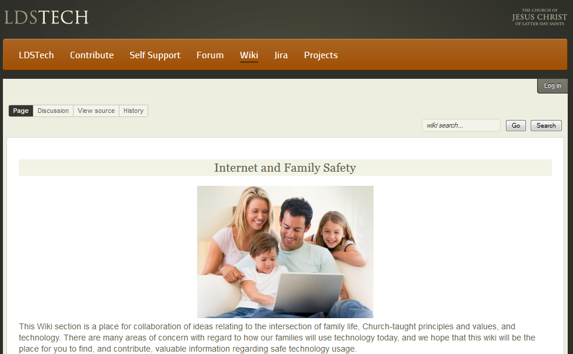
LDSTech Internet and Family Safety
Notes:
LDSTech - Internet and Family Safety
https://tech.lds.org/wiki/Family_Safety
The advantage of this website over many other web resources is that it’s written for LDS families and applies the LDS perspective to the topic of Internet and Family Safety

Slide 24
Conclusions
Improving family prayer, family scripture study and family home evening is always beneficial
Strengthening internet filtering is a useful defense against inappropriate Internet and media content
Notes:
Conclusions
Improving family prayer, family scripture study and family home evening is always beneficial to the health and welfare of your family
Strengthening internet filtering is a useful defense against inappropriate Internet and media content entering your home
Set the right example as parents
What did you find useful in this presentation?

Slide 25
Suggested Actions
Plan and hold a parent-child interview
Confirm that you have the typical home network configuration described
Evaluate Internet filtering alternatives
Read LDSTech Internet and Family Safety web pages
Notes:
Suggested Actions
Plan and hold a parent-child interview
Apply Twelve Tips for Parent-Child Interviews By Steven B. Glade
Confirm that you have the typical home network configuration described in place in your home
Typically this means confirming that you have a router between the Shaw modem and the computers in your home
You may also want to see if your neighbors are operating an unencrypted WiFi access point that is accessible from within your home
Evaluate Internet Filtering Alternatives
If you don’t have Internet Filtering in place, please evaluate the alternatives and set a course of action
Read LDSTech Internet and Family Safety web pages
Consider basing a family home evening on this content

Slide 26
Discussion
Notes:
Discussion
Notice child demonstrating computing for the family

Slide 27
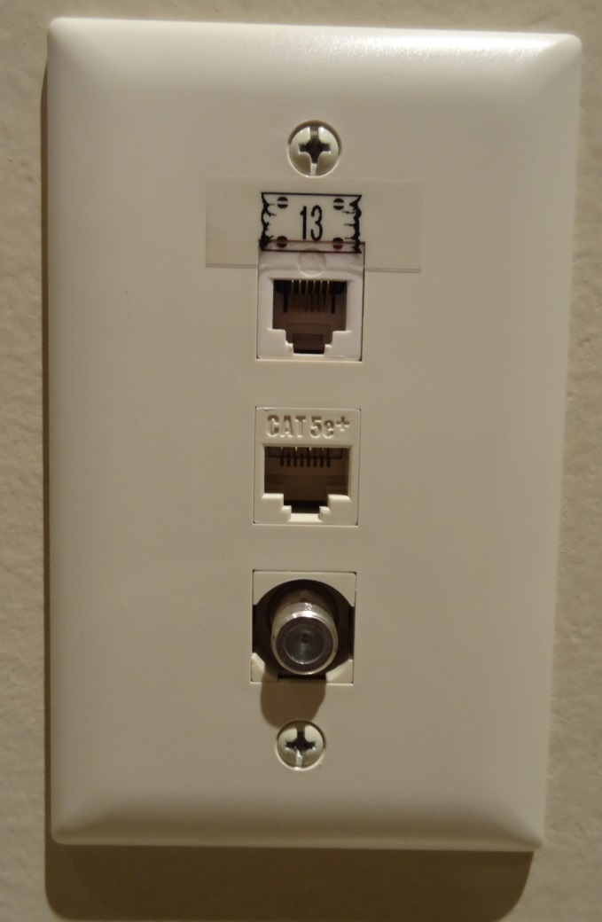
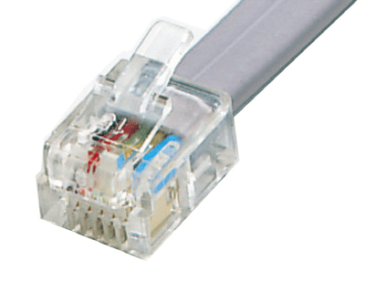
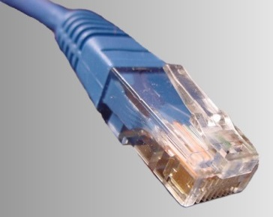
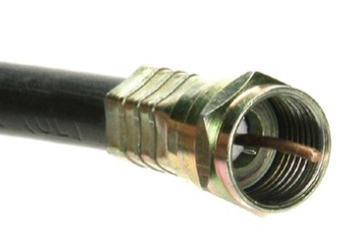
Network Types
Telephone twisted pair
Ethernet network
Digital TV coax
Notes:
Network Types
Installing this type of wall plug is the visible part of wiring your home for telephone, wired network and cable access
The other end of the wires behind the wall plug are typically gathered into three patch panels in the utility room in your basement
The telephone and wired network plugs are very similar; the cable plug is quite different
The wireless network is not represented because it relies on a radio signal that travels through the air between the computers and the wireless access point

Slide 28
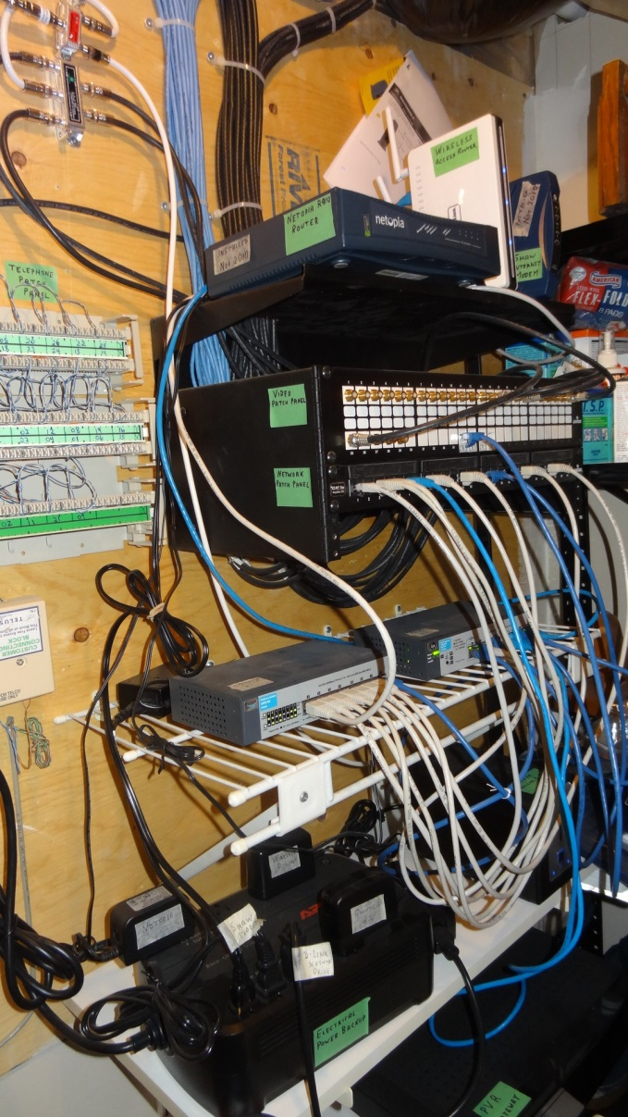
Network Components
Digital TV coax splitters
Network router
Shaw Internet modem
Telephone wiring
Wireless access point
Patch panel video
Patch panel Ethernet
Network switches
Backup disk drive
Power supply
Television PVR
Notes:
Network Components
These are the network components of a home network for telephone, wired network and cable access
Most homes rely much more heavily on wireless than this configuration because it’s extraordinarily difficult and expensive to install all the wires necessary for this capability in an existing home
It’s definitely worthwhile to incorporate all the wiring in a new home to:
Provide network access in every room
Avoid unsightly wires running along baseboards and across floors
Achieve the faster and more stable performance of wired Ethernet compared to wireless WiFi

Slide 29
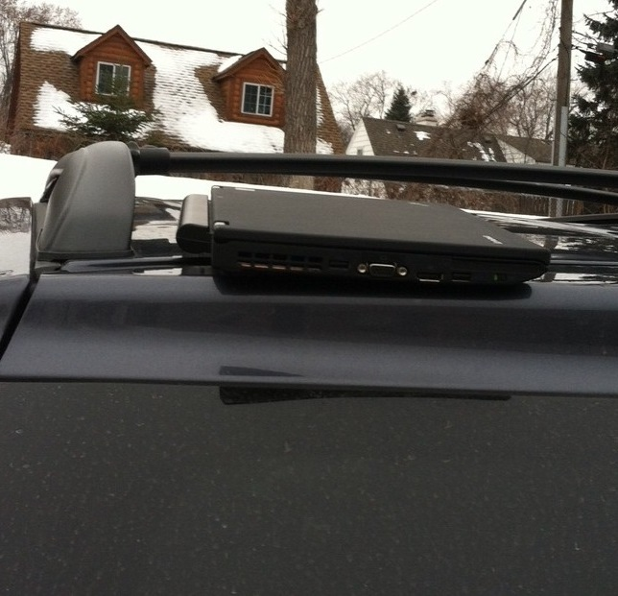
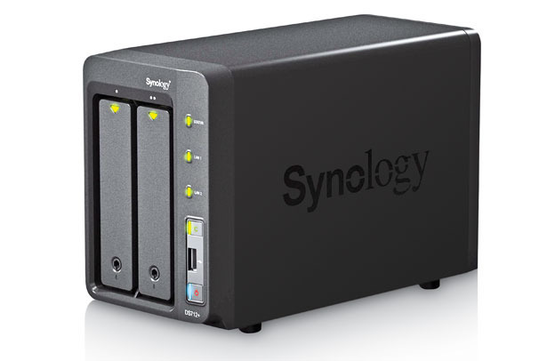
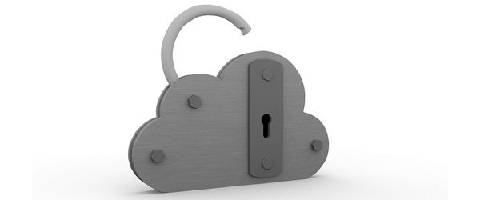
Home Backup Alternatives
Backup Basics
Same Machine Backup
External drive backup
Cloud-based backup
Notes:
Home Backup - Alternatives
Backup Basics
Basics is a summary discussion of the 3 major alternatives listed below
Backup is about having another copy or multiple copies of files available in the event of an accident or a disaster
Accident can be as simple as an accidental file over-write or an accidental file delete or an accidental drive reformat
Disaster can be a laptop drop, a fire or a stolen computer
Same Machine Backup
Copy the contents of a drive to another part of the same drive
External drive backup
Copy the contents of a drive to another drive on another computer
The photo shows removal backup drives you can easily store at another location such as an office
Cloud-based backup
Copy the contents of a drive to the datacenter of a service provider at some unknown location

Slide 30
Home Backup Alternatives
Backup Basics
http://www.itworld.com/consumerization-it/325698/how-backup-files-your-computer-part-1-basics
Same Machine Backup
http://www.itworld.com/consumerization-it/326389/best-home-backup-plan-options-part-2-same-machine-backup
External drive backup
http://www.itworld.com/consumerization-it/327820/best-home-backup-plan-options-part-3-external-drive-backup
Cloud-based backup
http://www.itworld.com/consumerization-it/328710/best-home-backup-plan-options-part-4-cloud-based-backup
Notes:
Home Backup Alternatives

Slide 31
Bibliography - 1
LDSTech - Internet and Family Safety
https://tech.lds.org/wiki/Family_Safety
LDSTech - Family safety with technology
https://tech.lds.org/wiki/Family_safety_with_technology
OpenDNS
http://www.opendns.com/
Parental Control & Monitoring
http://www.pcmag.com/category2/0,2806,1639158,00.asp
Notes:
Bibliography - 1

Slide 32
Bibliography – 2
Parent-Child Interviews, By Carlos E. Asay
General Conference - October 1983
https://www.lds.org/general-conference/1983/10/parent-child-interviews?lang=eng
Security and your Apple ID
http://support.apple.com/kb/HT4232
Telus - Parental control technology
Link
Telus - Security help
http://www.telus.com/content/help/internet-support/security.jsp
Notes:
Bibliography – 2

