Slide 1

Internet and
Media Safety for Families
Lesson 4
Teach your Children about Media Choices
<Ward name> <Date>
Notes:
Internet and Media Safety for Families
The Internet and media have become important, positive elements of our lives
Like other technologies that we use regularly, we need to manage the Internet and Media in our families
We all have rules in our family around appropriate television watching
We have rules for the safe operation of automobiles and other equipment like chain saws because they can be dangerous
We don’t let our children wander around with chain saws
We wear helmets when we ride a bicycle
The Internet and media are no different, just newer and perhaps less familiar to us than the other slightly older and more widely accepted technologies in our lives
We don’t watch certain movies, we don’t let some DVD’s into our homes
In the same way, we avoid inappropriate content on the Internet
How do we actually achieve this goal and ensure our families do likewise?
That’s what we want to talk about today
Some of you grandparents may think this presentation isn’t relevant to you; I disagree; you can be enormously influential among your children, their spouses and your grandchildren
Lesson created by Yogi Schulz in the fall of 2013 YogiSchulz@corvelle.com

Slide 2

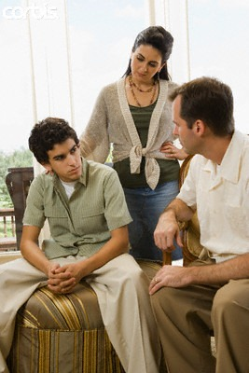
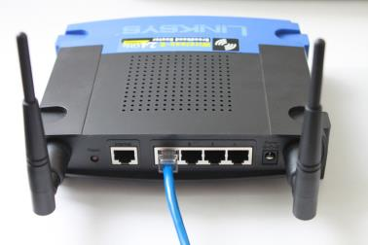


Lesson 3 Review
Internet and Media Safety for Families
Plan and hold a parent-child interview
Confirm that you have the typical home network configuration described
Evaluate Internet filtering alternatives
Read LDSTech Internet and Family Safety
web pages
Notes:
Lesson 3 Review - Internet and Media Safety for Families
Plan and hold a parent-child interview
Apply Twelve Tips for Parent-Child Interviews By Steven B. Glade
Confirm that you have the typical home network configuration described in place in your home
Typically this means confirming that you have a router between the Shaw modem and the computers in your home
You may also want to see if your neighbors are operating an unencrypted WiFi access point that is accessible from within your home
Evaluate Internet Filtering Alternatives
If you don’t have Internet Filtering in place, please evaluate the alternatives and set a course of action
Read LDSTech Internet and Family Safety web pages
Consider basing a family home evening on this content

Slide 3
Internet and Media Safety for Families
7-Lesson Sunday School Class
Children are an Heritage of the Lord
The Sacred Roles of Fathers and Mothers
Internet and Media Safety for Families
Teach your Children about Media Choices
Teach your Children to prevent/avoid Pornography
Teach Your Children about inappropriate Internet/Media Exposures
Make Emergency Response Plans
Notes:
Internet and Media Safety for Families - 7-Lesson Sunday School Class
This is the list of titles for the 7-Lesson Sunday School Class we have developed
This class relies heavily on the Marriage and Family Relations Part B: Parents’ Responsibilities To Strengthen Families
Lesson 1 - Children are an Heritage of the Lord
Lesson 2 - The Sacred Roles of Fathers and Mothers
Lesson 3 - Internet and Media Safety for Families
Lesson 4 - Teach your Children about Media Choices
Lesson 5 - Teach your Children to prevent/avoid Pornography
Lesson 6 - Teach Your Children about inappropriate Internet/Media Exposures
Lesson 7 - Make Emergency Response Plans

Slide 4

Lesson
Outline
Lesson Objectives
Parents are responsible to teach their children
Parents can receive inspiration in teaching their children
Parents teach by example and instruction
Suggested Actions
Notes:
Lesson Outline
LESSON 12: TEACHING CHILDREN THROUGH EXAMPLE AND INSTRUCTION
Parents are responsible to teach their children
Parents can receive inspiration to teach and protect their children
Parents teach children by example and instruction
Suggested Actions
we’ll wrap up with some pragmatic suggested actions we can all undertake
Discussion
You don’t need to be super polite and wait for the end of my remarks to comment
Please interject your ideas or ask questions any time

Slide 5

Lesson
Objectives
Ponder the needs of your children
Plan for opportunities to teach children through your actions and words
Review material on teaching in the family
Introduce material for teaching children about media choices
Notes:
Lesson Objectives
Ponder the needs of your children or the needs of grandchildren, nieces and nephews, or other children you know
Plan for opportunities to teach your children through your actions and words
Review the material on teaching in the family that is found in:
Teaching, No Greater Call (36123), pages 127–43
Family Guidebook (31180), pages 4–10
Introduce material for teaching children about media choices
Please try to lay out a plan together as husband and wife if at all possible

Slide 6
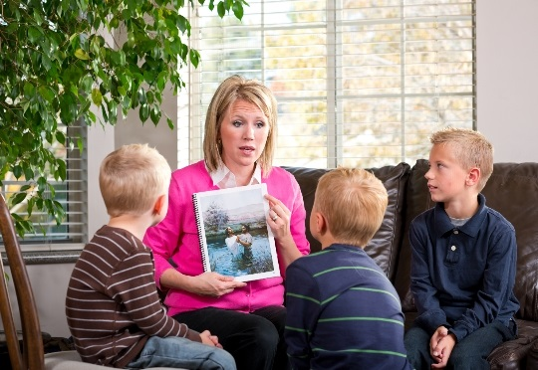
Parents are responsible to teach their children
Notes:
Parents are responsible to teach their children
Explain that the Lord has given parents a sacred duty to teach their children
This responsibility must not be ignored, taken lightly or left to others

Slide 7

Teenager Communication
Why do you
have to criticize
everything
I say?
Why does
everything you
say have to be
so criticizable?
Notes:
Teenager Communication
Cartoon: zits_20131026_863817
Why do you have to criticize everything I say?
Why does everything you say have to be so criticizable?
Sometimes our children, especially teenagers, become critical and sarcastic
They think their parents are old-fashioned, out of touch, too straight-laced, too conservative, too cautious and too timid
Teenagers tend to think they are invincible and immortal; nothing is beyond their understanding; they don’t recognize how short of wisdom they are
Teaching children and teenagers is not easy
Sometimes we feel like we’re not making much progress
We might be tempted to give up
Giving up is always the wrong answer

Slide 8

Elder
M. Russell Ballard
“We cannot and we must not allow the
school, community, television or even
Church organizations to establish our
children’s values
The Lord has placed this duty with
mothers and fathers
It is one from which we cannot escape and one that cannot be delegated
Others may help, but parents remain accountable
Therefore, we must guard the sanctity of our homes because that is where children develop their values, attitudes, and habits for everyday living”
Notes:
Explain that the Lord has given parents a sacred duty to teach their children
This responsibility must not be taken lightly or left to others
Elder M. Russell Ballard of the Quorum of the Twelve Apostles emphasized:
“We cannot and we must not allow the school, community, television, or even Church organizations to establish our children’s values
The Lord has placed this duty with mothers and fathers
It is one from which we cannot escape and one that cannot be delegated
Others may help, but parents remain accountable.
Therefore, we must guard the sanctity of our homes because that is where children develop their values, attitudes, and habits for everyday living”
Conference Report, Apr. 1991, 106; or Ensign, May 1991, 79–80

Slide 9

The Whirlpool Of THOROLD
Notes:
The Whirlpool Of THOROLD
Full length: 2 minutes 33 seconds; edited to: 56 seconds
http://www.youtube.com/watch?v=UlZsPbLG864&list=PLOVy26F3RPw98VtWLWC2Tkb2u4bU8QFV-&index=2&feature=plpp_video
Discuss how pornography or other Internet addictions can be like swimming near a whirlpool
While watching the video ask class members how close to the whirlpool they could swim without being pulled in and drowned. Or should they swim in that body of water at all?

Slide 10

What do we teach?
Basic Doctrinal Principles
Godhead
Plan of Salvation
Atonement of Jesus Christ
Dispensation, Apostasy, and Restoration
Prophets and Revelation
Priesthood and Priesthood Keys
Ordinances and Covenants
Marriage and Family
Commandments
Come, Follow Me Learning Resources for Youth:
  https://www.lds.org/youth/learn/guidebook/doctrinal?lang=eng
Notes:
What do we teach? Basic Doctrinal Principles
Godhead
Plan of Salvation
Atonement of Jesus Christ
Dispensation, Apostasy, and Restoration
Prophets and Revelation
Priesthood and Priesthood Keys
Ordinances and Covenants
Marriage and Family
Commandments
I invite you to read the supporting detail at the Church’s new website devoted to teaching our youth

Slide 11









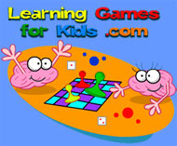




Wonderful Internet Resources
Communication
Entertainment
Education
Personal research
Gospel study
Shopping
Notes:
Wonderful Internet Resources
If the Internet can be hazardous or dangerous, why even use the internet?
Because, like most technologies, the Internet offers many wonderful, positive benefits
The challenge is to focus on the benefits and not become distracted or overwhelmed or sucked in by the hazards
Communication
Email
Instant messaging
Social media
Skype and Google video
Entertainment
Movies
Games
This is a really big feature of the Internet; I was shocked recently when the new Grand Theft Auto sold more than $1 billion copies in 4 days
Education
Formal
We now have the concept of a massive open online course (MOOC) is a class with unrestricted enrollment that takes place on the web. MOOCs are generally free and taught by university professors--often big-name academics that are incredibly appealing
Some of you may have heard of Khan Academy that offers many short video lessons on an incredibly wide range of topics
Informal
How-To education resources are huge on the Internet; how to bake a cake, how to change a tire, unfortunately also how to make a bomb
Personal and professional research
Reviews of consumer products: televisions, cars, computers, lawn movers, mixers, anything and everything
Medical information: diseases, pharmaceuticals, treatments
Ingredients of consumer products
Recipes for everything
Professional information for virtually all disciplines from plumbing to automotive to oil & gas to nuclear engineering and space flight
Gospel study
The LDS Church offers a vast variety of wonderful, uplifting content
Scriptures
Magazines
Church materials
Shopping
Product descriptions and reviews
Alternative and price comparison
Convenient purchasing
What have you used?
What websites have you found useful or interesting?

Slide 12

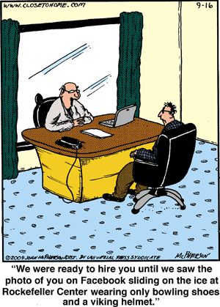

Stay Safe Tips for Social Networking
Don’t leave a computer when still logged in
Always be suspicious of others online
Don’t provide personal information
Never meet without taking someone with you
Only visit sites intended for your age
Check the privacy settings
Don’t interfere with other profiles
Post only items that are in good taste
Internet
“We were ready to hire you until we saw
the photo of you on Facebook sliding
on the ice at Rockefeller Center
wearing only bowling shoes and a Viking helmet”
Notes:
Stay Safe Tips for Social Networking
Don’t leave a computer when you’re still logged in
This is particularly important in public places like the library, Internet cafes or at hotels
Don’t let someone else ruin your reputation
Always be suspicious of others online
A few people out there in cyberspace display greatly misleading profiles
Don’t provide personal information at websites
Provide only the minimum for social media profiles
In particular, don’t enter birth dates and addresses
Avoid identity theft; Prevent stalking
Never meet in person with someone you’ve met only online without taking someone with you
There are predators out there
Always pick a large, public location like a big, noisy food court at a shopping center
If you’re buying something via Kijiji or AutoTrader, take someone with you
Only visit websites intended for your age
There are many inappropriate adult sites on the web
Check the privacy settings on your computer and your smartphone
Don’t assume the web browser defaults are best for you
Don’t interfere with other profiles
Don’t engage in malicious behaviour by breaking into websites or by usurping the email address of someone else
Delete email addresses and profiles you know longer use or care about
Post only items that are in good taste
Don’t make nasty, rude or untrue statements
Don’t post raunchy or lewd photos
The Internet has no Delete button; you cannot retract irresponsible or outlandish comments that will hurt your reputation
As much as we might like a delete button, we need to forget about this idea and behave responsibly on the Internet
“We were ready to hire you until we saw the photo of you on Facebook sliding on the ice at Rockefeller Center wearing only bowling shoes and a Viking helmet”
What have you read online that surprised you?
What photos can I find of you that you’d rather not have others see?
Consider discussing these points in a Family Home Evening

Slide 13
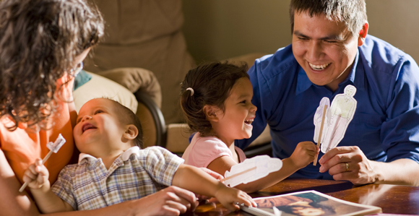
Parents can receive inspiration in teaching their children
Notes:
Parents can receive inspiration in teaching their children
Doctrine and Covenants 42:14
14 And the Spirit shall be given unto you ªby the prayer of faith; and if ye receive not the ^{b}Spirit ye shall not teach.
President Gordon B. Hinckley:
“You parents, love your children. Cherish them. They are so precious. They are so very, very important. They are the future. You need more than your own wisdom in rearing them. You need the help of the Lord. Pray for that help and follow the inspiration which you receive”
Conference Report, Oct. 1995, 120; or Ensign, Nov. 1995, 89

Slide 14

How do we teach?
Teaching in the Savior’s Way
He loved them
He knew who they were
He prepared Himself
He shared simple stories, parables, and real-life examples
He used the scriptures
He asked questions
He invited them to testify
He trusted them
He invited them to act in faith
He was their example and mentor
Come, Follow Me Learning Resources for Youth:
  https://www.lds.org/youth/learn/guidebook/teaching?lang=eng
Notes:
How do we teach? - Teaching in the Savior’s Way
Here are the elements of how the Saviour taught the people
He loved them
He knew who they were
He prepared Himself
He shared simple stories, parables, and real-life examples
He used the scriptures
He asked questions
He invited them to testify
He trusted them
He invited them to act in faith
He was their example and mentor
We can apply the same approach
I invite you to read the supporting detail at the Church’s new website devoted to teaching our youth

Slide 15

Watch Your Step
Notes:
Watch Your Step
See how a moment's decision can have far-reaching consequences—for good or bad
In this case, a brush with pornography leads to isolation from family and eventually to a family breakup to the detriment of all family members
https://www.lds.org/pages/mormon-messages?lang=eng&query=watch+your+step#watch-your-step
Length: 2 minute 39 seconds
Discuss how choices lead to consequences, both good and bad

Slide 16

Assessment
Surveys
Parent Media and Technology Survey
Student Media and Technology Survey
Discuss handouts
Notes:
Assessment Surveys
Survey documents located at this link: http://www.commonsensemedia.org/educators/educate-families/outreach-kits
Parent Media and Technology Survey
The parent survey assesses your opinions about a range of views about how the Internet can be used by your children
The parent survey also asks you about potential Internet-related topics you might want to think about discussing with your children and your confidence in addressing these topics
Student Media and Technology Survey
The student survey assesses student Internet usage for entertainment and social media
The student survey also asks about which Internet-related topics have been discussed with parents

Slide 17
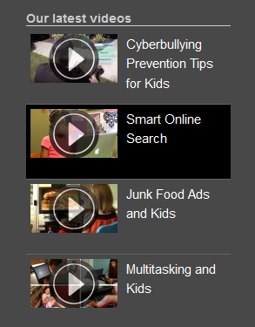
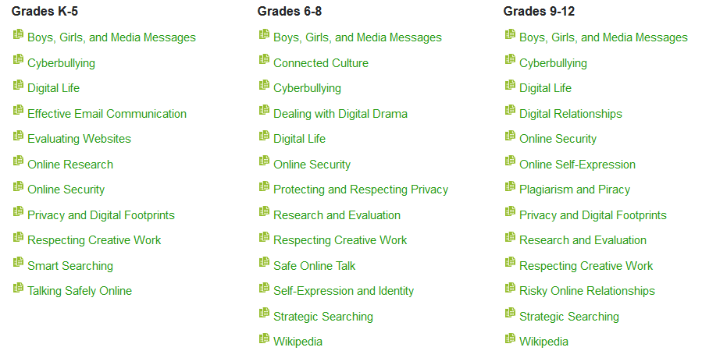
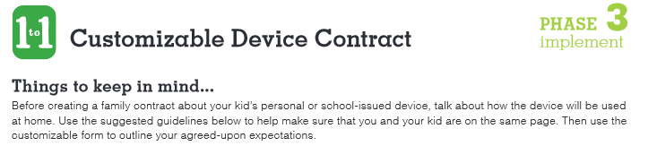

Educate Your Family
Host a Family Engagement Night
Share Advice Videos
Distribute Family Tip Sheets
Share Family Resources
Keep Families In-the-Know
Notes:
Educate Your Family about media safety and wise media choices
This is a set of resources that you can use to educate your family
Derived from Educate Families: A Home-to-School Program
http://www.commonsensemedia.org/educators/educate-families
Host a Family Engagement Night
Use this Outreach Kit, a collection of turnkey resources (flyers, quiz, presentations & scripts), to reach out to families about the digital world and how kids engage in it
http://www.commonsensemedia.org/educators/educate-families/outreach-kits
Share Advice Videos
Spark a conversation about current topics around parenting and media use with these Advice Videos. Filter your search by topic to find videos that best address your community’s needs
http://www.commonsensemedia.org/video/advice
Distribute Family Tip Sheets
Provide advice about current issues related to the age-appropriate topics we address in our K-12 Digital Literacy and Citizenship Curriculum with our actionable Family Tip Sheets
http://www.commonsensemedia.org/educators/educate-families/tip-sheets
Share Family Resources
Encourage families to discuss expectations for media and technology use at home with our Family Media Agreements, establish guidelines for responsible device care using our Customizable Device Contract, and discover the best learning products through Learning Ratings
Keep Families In-the-Know
Connect your families to Making Sense, Common Sense Media’s blog full of expert advice and common sense ideas about parenting, media, and everything in between
http://www.commonsensemedia.org/blog

Slide 18


Parents teach through example and instruction
Notes:
Parents teach through example and instruction
Explain that parents teach their children in two general ways: through their example and through their words.
Elder James E. Faust:
“When parents try to teach their children to avoid danger, it is no answer for parents to say to their children, ‘We are experienced and wise in the ways of the world, and we can get closer to the edge of the cliff than you.’
Parental hypocrisy can make children cynical and unbelieving of what they are taught in the home. For instance, when parents attend movies they forbid their children to see, parental credibility is diminished.
If children are expected to be honest, parents must be honest.
If children are expected to be virtuous, parents must be virtuous.
If you expect your children to be honorable, you must be honorable”
Conference Report, Oct. 1990, 41; or Ensign, Nov. 1990, 33–34

Slide 19
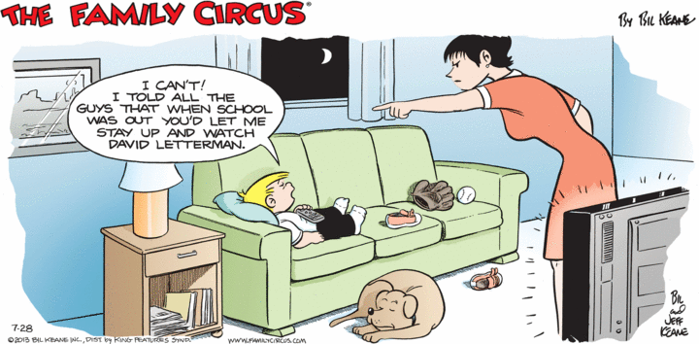
“I can’t go to bed.
I told all the guys that when school was out,
you’d let me stay up
and watch David Letterman!”
Notes:
“I can’t go to bed. I told all the guys that when school was out, you’d let me stay up and watch David Letterman!”
Cartoon: Family_Circus_2013_07_28.gif
This cartoon illustrates how easily our children are influenced by their peers around them at school and therefore how easily undesirable attitudes and behaviours can slip into the home
As parents we have an obligation to set appropriate rules for our family and make some effort to enforce those rules

Slide 20

Checking Browser History
Tips for Parents
Notes:
Checking Browser History - Tips for Parents
https://www.youtube.com/watch?v=9K7B_MZBL24
Length: 1 minute 36 seconds
Checking the browser history is always a quick, low effort way to gain insights into where a child has been surfing on the Web
If you’re not happy with what you see, that provides a great introduction for a conversation

Slide 21
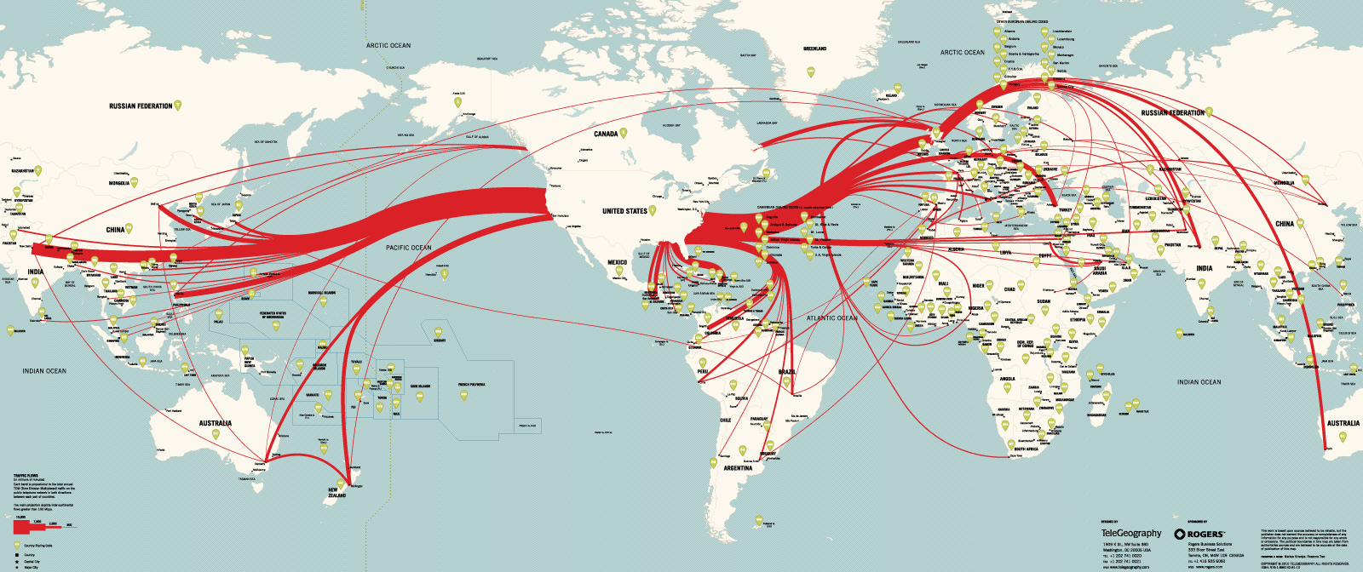
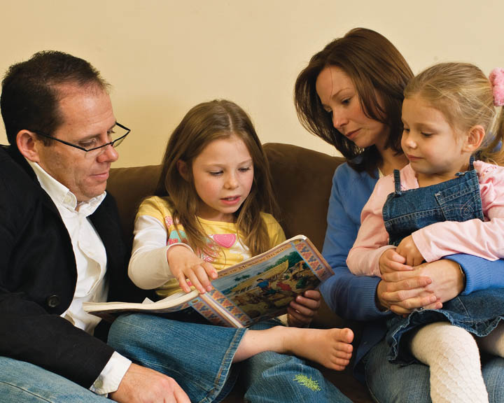


Conclusions
The Internet is a wonderful resource
Parents are responsible to teach children
Media choices influence children
Notes:
Conclusions
The Internet is a wonderful resource
Explore the Internet with your family
Use it to explain the wider world to your children
Parents are responsible to teach their children
Seize opportunities to teach your children
Media choices have a huge influence on children
Introduce material to teach children about media choices
What did you find useful in this presentation?

Slide 22


Suggested Actions
Review material on teaching youth
Introduce material for teaching children about media choices
Watch: Parents Need Rules, Too
Review children computer user accounts
Notes:
Suggested Actions
Review material on teaching youth at Come Follow Me on LDS.ORG
Introduce material for teaching children about media choices
You now have the Common Sense Media surveys and the links to the website; please use it in your families
Watch: Parents Need Rules, Too
Quick video on safe media rules in the family
Review children computer user accounts ensuring:
Each child has his or her own non-administrator account
Administrator accounts are needed to install software and circumvent parental controls
Parent knows each child’s password
Content of Internet browser histories is acceptable

Slide 23
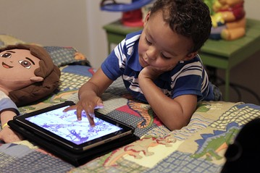


Discussion
Notes:
Discussion
The Internet appeals to all ages; even the youngest in our families

Slide 24
Bibliography - 1
Marriage and Family Relations - Instructor’s Manual
  http://www.lds.org/manual/marriage-and-family-relations-instructors-manual?lang=eng
Marriage and Family Relations - Participant’s Study Guide
  http://www.lds.org/manual/marriage-and-family-relations-participants-study-guide?lang=eng
Notes:
Bibliography - 1

Slide 25
Bibliography - 2
Bill Gates on Education and Good Teachers
  https://www.youtube.com/watch?v=Q80XpChrYSM
Computer in your child's bedroom disturbs sleep and can lead to memory problems and poor marks in school
  http://www.dailymail.co.uk/health/article-2378417/Computer-childs-bedroom-disturbs-sleep-lead-memory-problems-poor-marks-school.html
The five signs your child is addicted to their iPad - and how to give them a 'digital detox'
  http://www.dailymail.co.uk/sciencetech/article-2479109/The-signs-child-addicted-iPad--digital-detox.html
Notes:
Bibliography - 2

Slide 26
Bibliography - 3
Parents Need Rules, Too
  Parenting today means teaching kids how to use digital media responsibly. These rules of the road will help pave the way
  http://www.commonsensemedia.org/videos/parents-need-rules-too
TELUS WISE®
  Wise Internet and Smartphone Education
  http://wise.telus.com/
12 Principles of Child Development and Learning that Inform Practice
  https://www.naeyc.org/dap/12-principles-of-child-development
Notes:
Bibliography - 3

Slide 27
12 Principles of Child Development and Learning that Inform Practice
All areas of learning are important
Learning follow sequences
Learning proceed at varying rates
Learning results from maturation and experience
Early experiences have profound affects learning
Development proceeds toward greater complexity
Children develop best with secure relationships
Learning occurs through social and cultural contexts
Children learn in a variety of ways
Play is important for social competence
Learning advance when children are challenged
Children’s experiences shape their motivation
Notes:
12 Principles of Child Development and Learning that Inform Practice
https://www.naeyc.org/dap/12-principles-of-child-development
All areas of development and learning are important
Development and learning follow sequences
Development and learning proceed at varying rates
Development and learning result from an interaction of maturation and experience
Early experiences have profound effects on development and learning
Development proceeds toward greater complexity, self-regulation, and symbolic or representational capacities
Children develop best when they have secure relationships
Development and learning occur in and are influenced by multiple social and cultural contexts
Children learn in a variety of ways
Play is an important vehicle for developing self-regulation and promoting language, cognition, and social competence
Development and learning advance when children are challenged
Children’s experiences shape their motivation and approaches to learning

