Slide 1
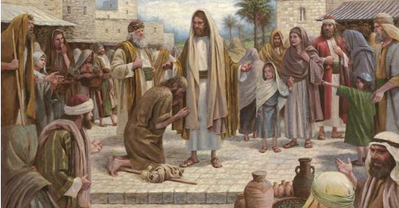
Matthew 8-9;Mark 2-5
Mar 04 – mar 10

Slide 2
Invite Sharing
Ask the children to share a story of Jesus performing a miracle (see the list of miracles in this week’s outline in Come, Follow Me—For Individuals and Families).
You could also show related pictures (see Gospel Art Book, nos. 40, 41, or LDS.org).

Slide 3
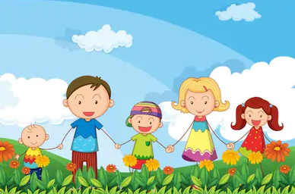

Teach the Doctrine
Click here for the “Younger Children’s” Program
Click here for the “Older Children’s” Program

Slide 4
Encourage learning at Home
Help the children write down an act of service they will perform for someone this week.

Slide 5
Our Closing Prayer will be given by
(Enter name here)

Slide 6
THE END

Slide 7
Images and clipart are from lds.org, Microsoft Office, and other websites indicating the images were in the public domain or permitted for church and home use.
The lesson and scripture story are from lds.org.
Please do not use this presentation for commercial use. Feel free to alter the presentation for use in church or home to suit personal preference.
This presentation is intended to supplement, not replace, the lesson manual and scriptures.
Teachers should refer to the manual, scriptures and other resources when preparing and conducting the lesson.

Slide 8
Younger program

Slide 9
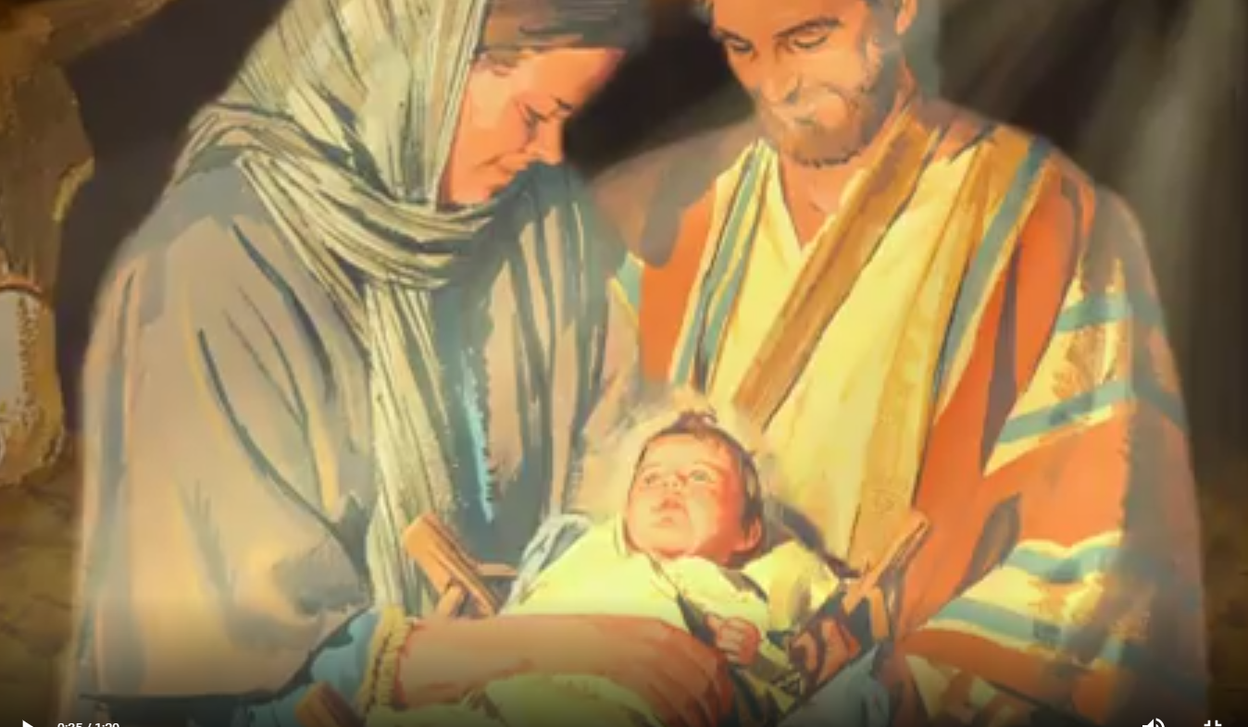
Jesus has power to perform miracles.
As you read about the Savior’s miracles of healing, ponder which miracles to share.
How can you help the children you teach understand the role of faith in the miracles Jesus performed?

Slide 10
Jesus has power to perform miracles.
Click on the Activity below that you want to go to:
Possible Activity ‘A’
Possible Activity ‘B’
Possible Activity ‘C’
Possible Activity ‘D’
Possible Activity ‘E’

Slide 11
When I am afraid or in danger, Jesus can help me feel peace.
The account of Jesus calming a storm can help children know that He can give them peace when they feel afraid.

Slide 12
When I am afraid or in danger, Jesus can help me feel peace.
Click on the Activity below that you want to go to:
Possible Activity ‘A’
Possible Activity ‘B’
Possible Activity ‘C’

Slide 13
Older program

Slide 14
Jesus can perform miracles in my life as I have faith in Him.
Jesus performed many miracles during His mortal ministry.
How can you help the children be aware that miracles happen today?

Slide 15
Jesus can perform miracles in my life as I have faith in Him.
Click on the Activity below that you want to go to:
Possible Activity ‘A’
Possible Activity ‘B’
Possible Activity ‘C’

Slide 16
I can show love for others as Jesus did.
Jesus showed great love by healing the sick and afflicted.
Ponder how you can teach the children to show compassion for people in need.

Slide 17
I can show love for others as Jesus did.
Click on the Activity below that you want to go to:
Possible Activity ‘A’
Possible Activity ‘B’
Possible Activity ‘C’

Slide 18
When I am afraid or in danger, Jesus can help me feel peace.
Children need to know that the Savior can give them peace when they face the storms of life﻿—now and in the future.

Slide 19
When I am afraid or in danger, Jesus can help me feel peace.
Click on the Activity below that you want to go to:
Possible Activity ‘A’
Possible Activity ‘B’
Possible Activity ‘C’
Possible Activity ‘D’

Slide 20
Younger Possible 1

Slide 21
Jesus has power to perform miracles.
Possible Activity ‘A’
Share the account of the man with palsy from Mark 2:1–12.
For help, see “Chapter 23: The Man Who Could Not Walk,” New Testament Stories, 57–58, or the corresponding video (LDS.org).
Tell the children that the man with palsy could not walk.
Help them recognize that this man was healed and forgiven by the Savior.

Slide 22
Jesus has power to perform miracles. Possible Activity ‘B’
Invite the children to pretend they are “waking up” like the daughter of Jairus as you read from Mark 5:22–23, 35–43.
Help them understand that Jesus has made it possible for all of us to have eternal life.

Slide 23
Jesus has power to perform miracles.
Possible Activity ‘C’
Read Mark 5:34.
Help the children memorize the phrase “Thy faith hath made thee whole,” perhaps by giving each child a word and then having the children say their words in order.
Has anyone they know ever been healed when they were sick?

Slide 24
Jesus has power to perform miracles. Possible Activity ‘D’
Ask the children to close their eyes and listen as you read from Matthew 9:27–30.
When you read about Jesus healing the blind men, invite the children to open their eyes.
How would the children feel if Jesus had healed them?

Slide 25
Jesus has power to perform miracles.
Possible Activity ‘E’
Invite the children to talk about a time when they were sick.
Tell one of the accounts of Jesus healing the sick, and testify that Jesus’s power can heal and bless us as we pray and receive priesthood blessings.
Explain that although the Lord sometimes does not give us the miracles we desire, He loves us and is aware of our needs.
He will give us the comfort we need.

Slide 26
Younger Possible 2

Slide 27
When I am afraid or in danger, Jesus can help me feel peace. Possible Activity ‘A’
Help the children imagine that they are on the ship as you read Mark 4:35–41. (See also “Chapter 21: Jesus Commands the Winds and the Waves,” New Testament Stories, 53, or the corresponding video on LDS.org.)
Ask the children to describe how they might have felt if they had been there.
When have the children been scared?
How did they find comfort?

Slide 28
When I am afraid or in danger, Jesus can help me feel peace. Possible Activity ‘B’
Invite the children to make the sounds of a storm and stop when someone says “Peace, be still.”
Testify that just as Jesus can bring us peace when there is a storm outside, He can bring us peace in our hearts when we feel bad on the inside.

Slide 29
When I am afraid or in danger, Jesus can help me feel peace. Possible Activity ‘C’
Think of actions to accompany the third verse of “Tell Me the Stories of Jesus,” Children’s Songbook, 57.

Slide 30
Older Possible 1

Slide 31
Jesus can perform miracles in my life as I have faith in Him.- Possible Activity ‘A’
Ask the children to pick one of the following miracles to read about and draw: Mark 2:1–12; Mark 5:22–23, 35–43; or Mark 5:24–34.
Invite the children to explain their drawings to the class.
What do they learn about Jesus from these stories?

Slide 32
Jesus can perform miracles in my life as I have faith in Him.- Possible Activity ‘B’
Ask the children to act out how they feel when they are sick, sad, afraid, or worried.
How can Jesus help us when we have these feelings?
Testify that Jesus can help the children in all of these situations.

Slide 33
Jesus can perform miracles in my life as I have faith in Him.- Possible Activity ‘C’
Invite the children to share experiences when they or someone they know received a priesthood blessing.
How was that person healed or blessed?

Slide 34
Older Possible 2

Slide 35
I can show love for others as Jesus did.
Possible Activity ‘A’
Choose one or more of Jesus’s miracles to review with the children, such as those in Mark 2:1–12; Mark 5:22–23, 35–43; or Mark 5:24–34. (See also the videos “Jesus Forgives Sins and Heals a Man Stricken with Palsy,” “Jesus Raises the Daughter of Jairus,” and “Jesus Heals a Woman of Faith” on LDS.org.)
Invite the children to share a time when they helped someone in need and how they felt.

Slide 36
I can show love for others as Jesus did.
Possible Activity ‘B’
Show the video “Gordon Hinckley: Lessons I Learned as a Boy” or “The Coat” (LDS.org).
How did the boys in these videos follow Jesus’s example?
Invite the children to share other situations when someone might be in need.
What can we do to help them?

Slide 37
I can show love for others as Jesus did.
Possible Activity ‘C’
Remind the children that helping others is part of their baptismal covenants (see Mosiah 18:8–10; Alma 34:28).

Slide 38
Older Possible 3

Slide 39
When I am afraid or in danger, Jesus can help me feel peace. Possible Activity ‘A’
Ask one of the children to use Mark 4:35–41 and the picture Jesus Calms the Storm (Gospel Art Book, no. 40) to tell the story of Jesus calming the storm.
Ask the children to describe how they might have felt if they had been there.

Slide 40
When I am afraid or in danger, Jesus can help me feel peace. Possible Activity ‘B’
Invite the children to share experiences when they felt peace after praying for help.
Remind them that this peace comes from the Savior.

Slide 41
When I am afraid or in danger, Jesus can help me feel peace. Possible Activity ‘C’
Sing “Master, the Tempest Is Raging,” Hymns, no. 105, with the children, inviting them to whisper when they sing “Peace, be still.”

Slide 42
When I am afraid or in danger, Jesus can help me feel peace. Possible Activity ‘D’
Give each child a paper rain cloud, and ask them to write on it a trial that someone might have.
Put all of the clouds on the board, covering a picture of the Savior.
Invite a child to remove one of the clouds and suggest ways we could help someone with that trial to find peace.
When all the clouds are removed, testify of the Savior’s power to calm the storms in our lives.

Slide 43
Resources

Slide 44









Slide 45
Referenced Scriptures

